Slide 1

Distributed & Cloud Computing
Welcome
Class: BS(CS)-VII
Sukkur IBA University – Kandhkot Campus
Week - 01
Lecture – 01 & 02
Your Facilitator, Adil Khan

Slide 2
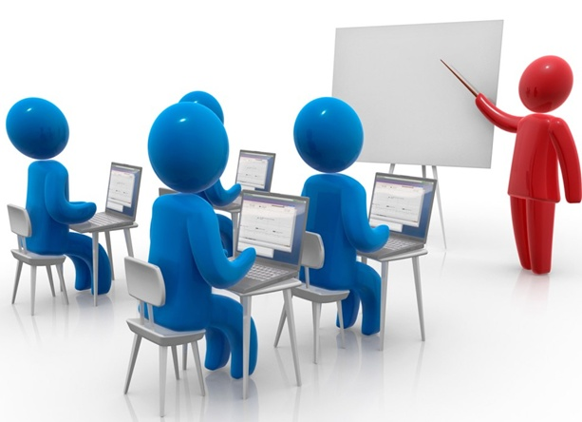
About Course

Slide 3
Course Objectives
We will study:
Fundamental Concepts of Cloud Computing
Basic concepts of distributed, grid, cluster, and utility computing architectures
Virtualization, containerization, and dockerization
Working with different cloud storage models
MapReduce and Spark platforms

Slide 4
Learning Outcomes
Define and explain the fundamental ideas behind Cloud Computing, the evolution of the paradigm, its applicability; and benefits; Also understand how to use Cloud Services, deployment models, SLAs and SLOs.
Understand the importance of Virtualization and containerization technologies in cloud.
Describe and implement open source private cloud platform using OpenStack.
Also understand the working of different cloud storage services and distributed cloud programming models

Slide 5
Recommended Books
K. Hwang, G. Fox, and J. Dongarra, Distributed and Cloud Computing: from Parallel Processing to the Internet of Things
R. Buyya, J. Broberg, and A. Goscinski (eds), Cloud Computing: Principles and Paradigms

Slide 6
Grading Policy
Theory | Marks
Mid – I | 20 %
Mid – II | 20 %
Assignment | 10 %
Quiz | 10%
Final | 40 %
Total | 100 %

Slide 7


Slide 8
Agenda
An overview of Computing
Trends in Computing (To distinguish Cloud Computing from previous generations)
Distributed Computing
Grid Computing
Cluster Computing
Utility Computing
Cloud Computing

Slide 9
What is Computing?
Computing is any activity that uses computers to manage, process, and communicate information.

Slide 10
Trends in Computing
Distributed Computing
Cluster Computing
Grid Computing
Utility Computing
Cloud Computing

Slide 11
Distributed Computing

Slide 12
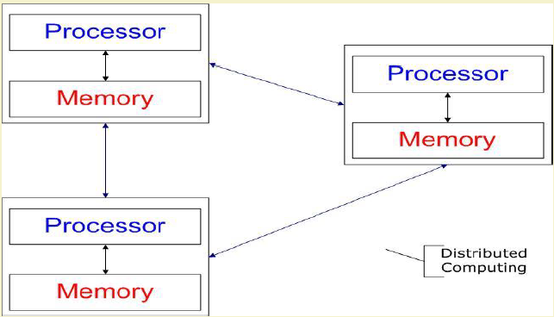
Distributed Computing
Distributed computing is group of computers working together as to appear as a single computer to the end user
Wikipedia
Several autonomous computational entities, each of which has its own local memory.
The entities communicate with each other by message passing.
Operating System Concept
The processors communicate with one another through various communication lines, such as high-speed buses or telephone lines.
Each processor has its own local memory.

Slide 13
Examples
Internet
ATM (bank) machines
Intranets/Workgroups

Slide 14
Computers in a Distributed System
Workstations:
Computers used by end-users to perform computing
Server Systems:
Computers which provide resources and services
Personal Assistance Devices:
Handheld computers connected to the system via a wireless communication link.

Slide 15
Common properties of Distributed Computing
Fault tolerance
When one or some nodes fails, the whole system can still work fine except performance.
Each node play partial role
Each computer has only a limited, incomplete view of the system.
Each computer may know only one part of the input.
Resource sharing
Each user can share the computing power and storage resource in the system with other users
Load Sharing
Dispatching several tasks to each nodes can help share loading to the whole system.
Easy to expand
We expect to use few time when adding nodes. Hope to spend no time if possible.
Performance
Parallel computing can be considered a subset of distributed computing

Slide 16
Why Distributed Computing?
Nature of application
Performance
Computing intensive
The task could consume a lot of time on computing. For example, Computation of Pi value using Monte Carlo simulation
Data intensive
The task that deals with a large amount or large size of files. For example, Facebook, LHC(Large Hadron Collider) experimental data processing.
Robustness
No SPOF (Single Point Of Failure)
Other nodes can execute the same task executed on failed node.

Slide 17
Distributed Applications
Applications that consist of a set of processes that are distributed across a network of machines and work together as an ensemble to solve a common problem
In the past, mostly “client-server”
Resource management centralized at the server
“Peer to Peer” computing represents a movement towards more “truly” distributed applications

Slide 18
Distributed Applications
Distributed application based on peer processes
Clients invoke individual servers

Slide 19
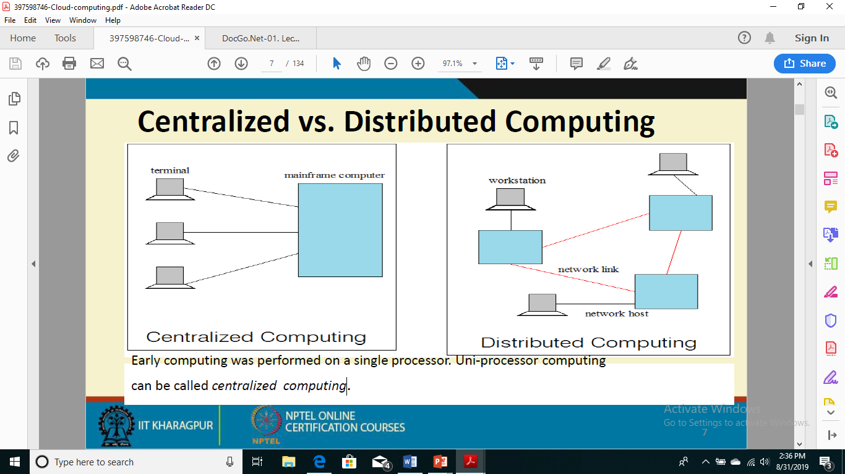
Centralized vs Distributed Computing
Early computing was performed on a single processor. Uni-processor computing can be called centralized computing

Slide 20
Cluster Computing

Slide 21
What is Cluster Computing?
A type of parallel or distributed computer system
A collection of inter-connected stand-alone computers working together as a single integrated computing resource.
Key components of a cluster include:
Multiple standalone computers
Operating systems
High-performance interconnects
Middleware
Parallel programming environments
Applications.

Slide 22
Cluster Computing
In a typical cluster:
Network: Faster, closer connection than a typical network (LAN)
Low latency communication protocols
Loosely coupled than Symmetric Multiprocessing (SMP)

Slide 23
Types of Cluster
High Availability or Failover Clusters
Load Balancing Cluster
Parallel/Distributed Processing Clusters

Slide 24
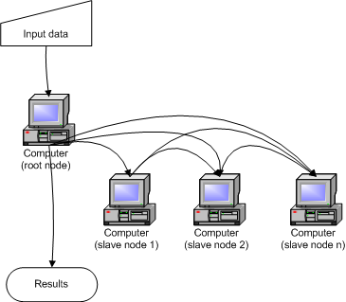
How Cluster Works?

Slide 25
Benefits of Cluster
System availability:
Due to the redundancy of hardware, operating systems, and applications.
Hardware fault tolerance:
Redundancy for most system components (eg. disk-RAID), including both HW & SW
OS and application reliability:
Run multiple copies of the OS and applications
Scalability:
Adding servers to the cluster as the need arises.
High performance

Slide 26
Grid Computing

Slide 27
What is Grid Computing?
IBM
Grid computing enables the virtualization of distributed computing and data resources such as processing, network bandwidth and storage capacity to create a single system image, granting users and applications seamless access to vast IT capabilities. Just as an Internet user views a unified instance of content via the Web, a grid user essentially sees a single, large virtual computer.
Sun Microsystems
Grid Computing is a computing infrastructure that provides dependable, consistent, pervasive and inexpensive access to computational capabilities
Pcwebopedia.com
A form of networking. unlike conventional networks that focus on communication among devices, grid computing harnesses unused processing cycles of all computers in a network for solving problems too intensive for any stand-alone machine.

Slide 28
Grid Computing
Grid
Users (or client applications) gain access to computing resources (processors, storage, data, applications, and so on) as needed with little or no knowledge of where those resources are located or what the underlying technologies, hardware, operating system, and so on are
“The Grid" links together computing resources (PCs, workstations, servers, storage elements) and provides the mechanism needed to access them.

Slide 29
Need of Grid Computing
Today’s Science/Research is based on computations, data analysis, data visualization & collaborations
Computer Simulations & Modelling are more cost effective than experimental methods
Scientific and Engineering problems are becoming more complex & users need more accurate, precise solutions to their problems in shortest possible time
Data Visualization is becoming very important
Exploiting under utilized resources

Slide 30
Applications
Weather Forecast
Detection and Modeling of Natural Disasters
Physics Application
And many others

Slide 31
Types of Grid
Computational Grid:
HTC and HPC.
Data Grid:
Support data storage, data discovery, data handling, data publication, and data manipulation of large volumes of data.
Collaboration Grid:
With the advent of Internet, there has been an increased demand for better collaboration. Such advanced collaboration is possible using the grid.
Network Grid:
A Network Grid provides fault-tolerant and high-performance communication services.
Utility Grid:
This is the ultimate form of the Grid, in which not only data and computation cycles are shared but software or just about any resource is shared.

Slide 32
Utility Computing

Slide 33
What is Utility Computing?
Utility Computing is purely a concept which cloud computing practically implements.
Utility computing is a service provisioning model in which a service provider makes computing resources and infrastructure management available to the customer as needed, and charges them for specific usage rather than a flat rate.
The word utility is used to make an analogy to other services, such as electrical power
sometimes known as pay-per-use

Slide 34
Utility Computing?
Pay-for-use Pricing Business Model
Data Center Virtualization
Solves Resource Utilization Problem
Outsourcing
Web Services Delivery

Slide 35
Payment Model
Same range of charging models as other utility providers: gas, electricity, telecommunications, water, television broadcasting
Flat rate
Subscription
Metered
Pay as you go
Different pricing models for different customers based on factors such as scale, commitment and payment frequency

Slide 36
Distributed vs Grid vs Cluster vs Utility
Distributed Computing is managing or pooling the hundreds or thousands of computer systems to solve a large computational problem.
Grid computing has some extra characteristics. Efficiently utilization of a pool of heterogeneous systems; more wide scale and geographically distributed
Cluster computing consists of homogenous hardware and OS; geographically connected by LAN
Utility computing is a service provisioning model; computing resources available for consumers as needed.

Slide 37
Thank you!
Any Questions???

